Slide 1


Online Ordering System

Slide 2
Supervisor
Akhlak Uz Zaman Ashik
Assistant Professor Metropolitan University, Sylhet
Presented By
Md. Rayhan ahmed
ID: 181-115-013
CSE 44th (A) Batch
Md. Jabed Hossain Sujel
ID: 181-115-034
CSE 44th (A) Batch

Slide 3

Introduction
ER Diagram
Objective
GUI of our platform
Tools & Technology
Feasibility
Block Diagram
Future Plan

Slide 4

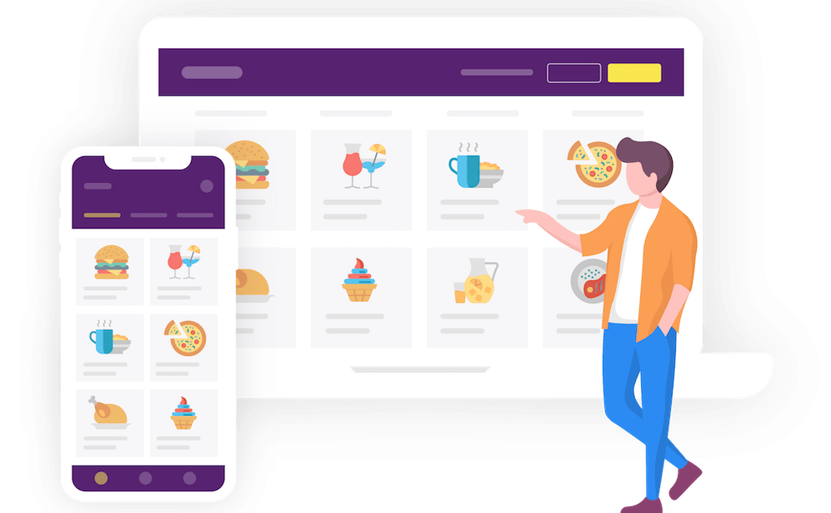

Introduction
Web application
Provide the opportunity to its user to order products online.
Complete e-commerce platform
Why we use
RJ Online Shop
Huge selection and variety of products
Easy checkout process
Communication system
Security system

Slide 5


Objective
Information
Order
Learn
Web based automated system.
Cover all the information of product‘s.
Maintain the details of products .
Customer to order what they need.
Add to cart & checkout
Everyone can save the time.
To learn and implement a real-time application on database (DB).

Slide 6
Tool‘s and Technology
HOW MANY TECHNOLOGY HELPS ME
DO THE WORK
01
02
Frontend
Backend
Vue JS
JQuery
Bootstrap 4
PHP
03
04
Framework
Database
Laravel
MySQL

Slide 7
Block Diagram
Initialization Interface
Search Product
Products Information
About Authors
Contact us
Sign in
Log in
Server Error
Add to Cart
Checkout
Dashboard
Product Type
Customer
Log Out
Product Setup
Message Setup
Admin
Stocks Setup
Brands Setup
Shipping Address
Order
Order Setup
Roles Setup

Slide 8
The Entity Relationship Diagram
roles
Relationship
Relationship
Relationship
Relationship
product_type
stocks
products
addresses
users
Relationship
brands
Relationship
Relationship
messages
orders
order_items
Relationship

Slide 9

Graphical User interface of our platform
Online ordering system has mainly three user interface.
These are
Viewer
Customer
Admin

Slide 10
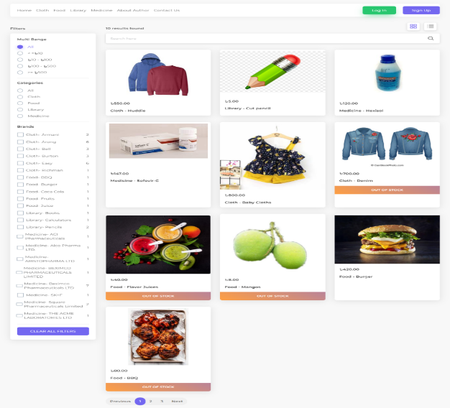
Viewer
Home Page
Where viewers can see the product according to the category, brand and money range of their choice.

Slide 11
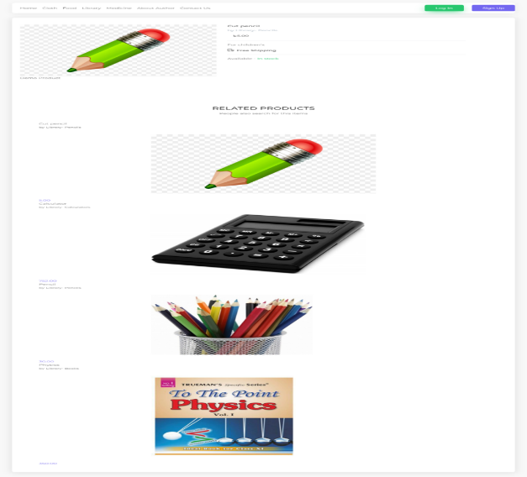
Product Information
Viewers can also view the product information and other related products according to their categories

Slide 12
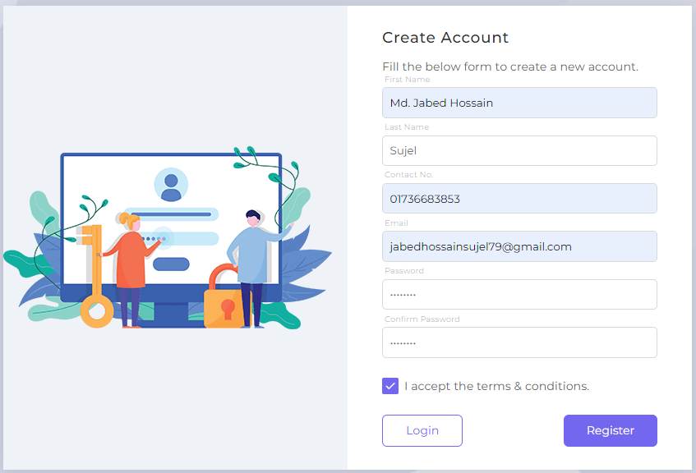
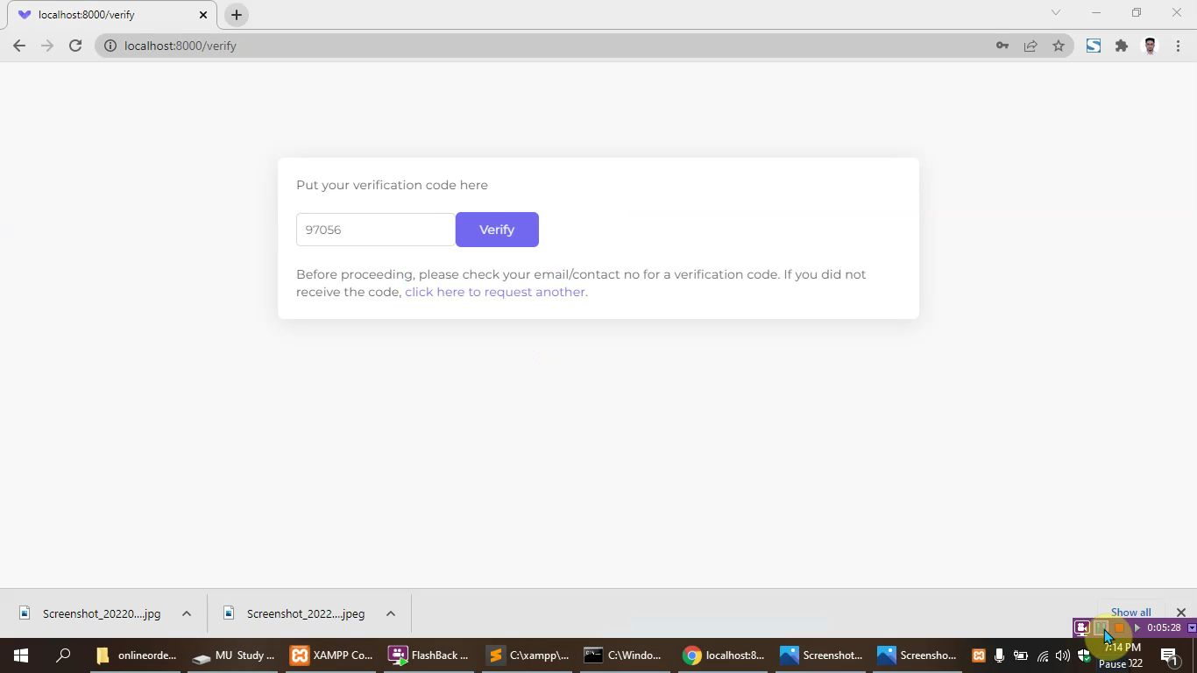
Customer
Customer Registration Form
The customer must fill out the registration form to order anything
OTP code
In this case a customer must give him valid email and registered numbers before registering. Otherwise, customer will not be able to register.

Slide 13
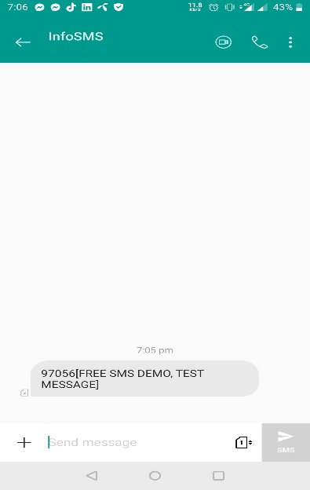
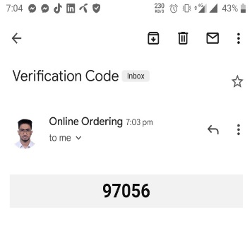
Verification Process
Email Verification Code
SMS Verification Code
When a customer registers with his/her valid email, an email verification code will be sent to his/her email from our website
When a customer registers with his/her number, an SMS verification code will be sent to his/her mobile number from Nexmo SMS Provider

Slide 14
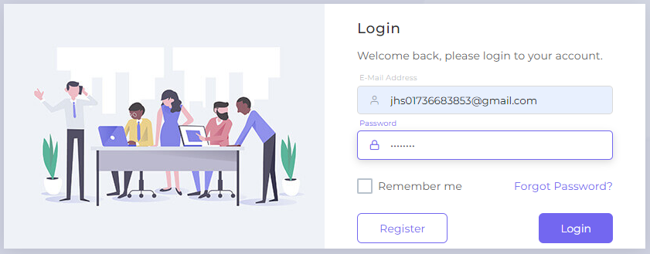
Customer Login
When the registration is completed, customer has to login with correct email and password

Slide 15

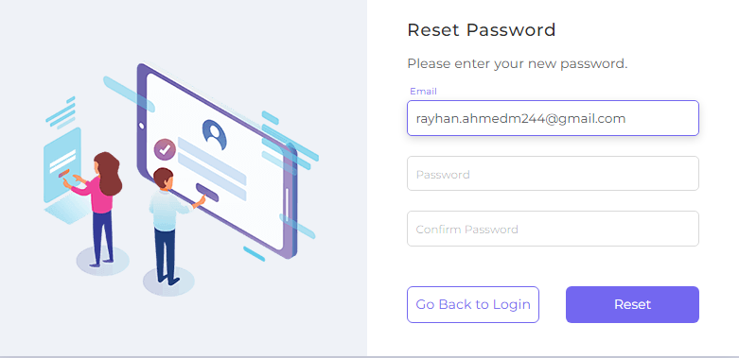
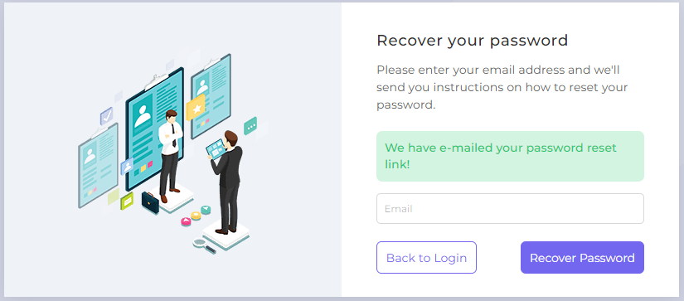
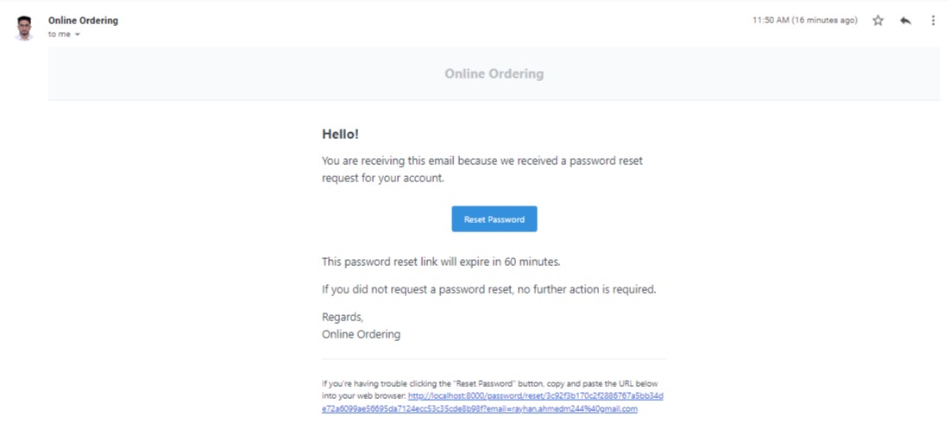
Password Recovery System

Slide 16
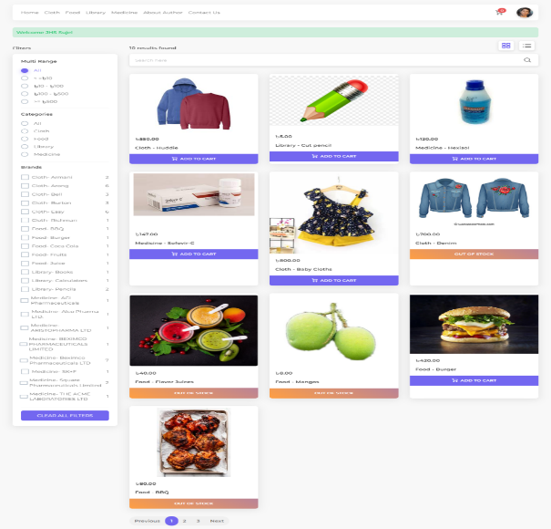
Customer Home Page
This type of interface will appear in front of the customer after login. Where customer can find the information to his/her choice and also know if it is in stock.

Slide 17
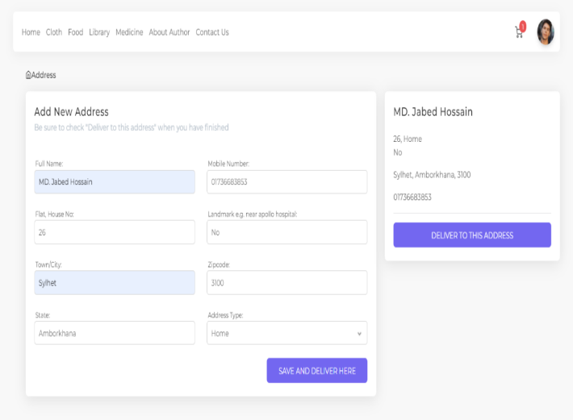
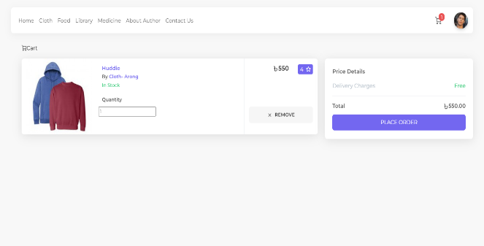
Shipping Address form
In order to order the product, customer must send valid address. He need to checkout to make the order successful.
Add to Cart
Customer will be able to add the product of their choice by clicking the mouse.

Slide 18
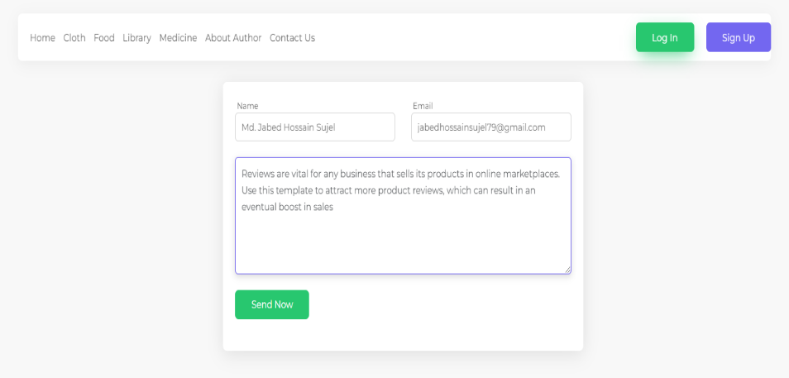
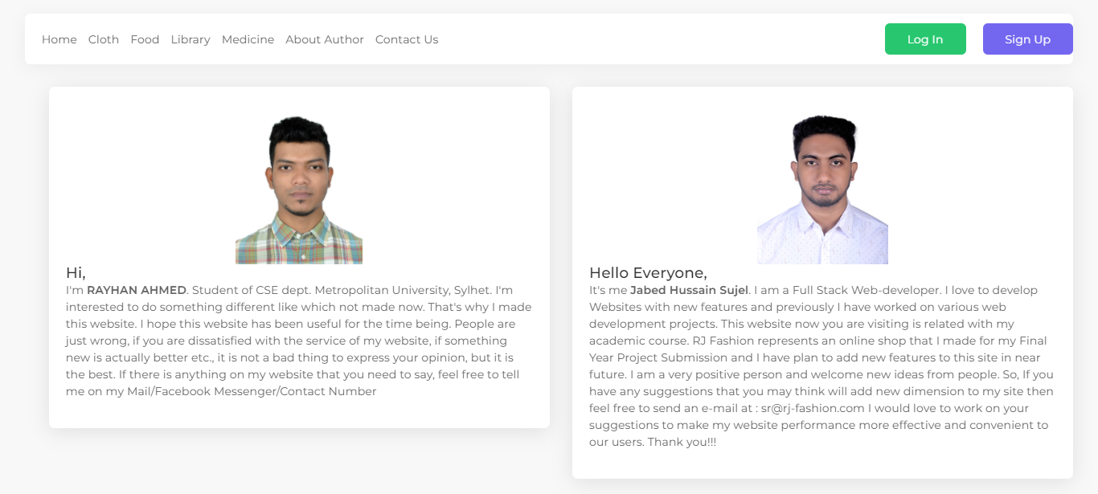
Message and Author details
Both visitor‘s and customers can send a message to the admin panel also can see the author details.

Slide 19
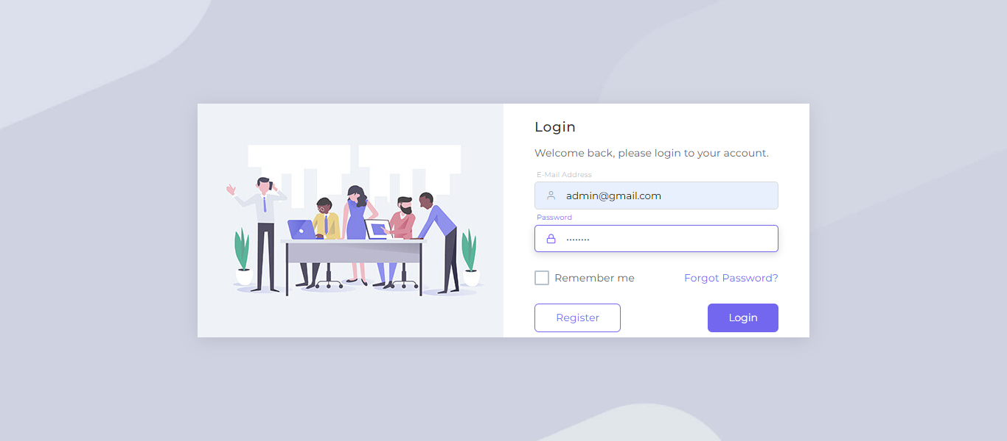
Admin
Admin Login
Admin has login with correct email and password.

Slide 20
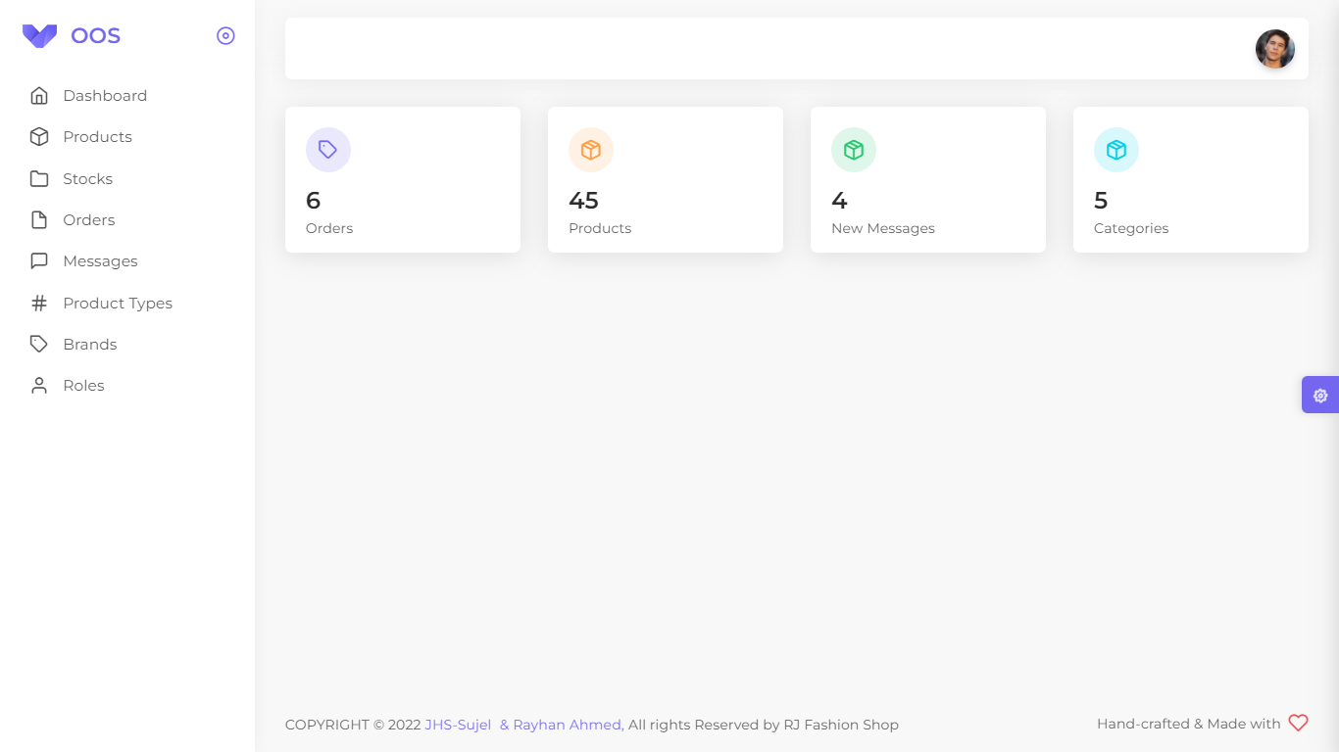
Dashboard
It will show the interface of how many orders, products, messages and categories there are.

Slide 21
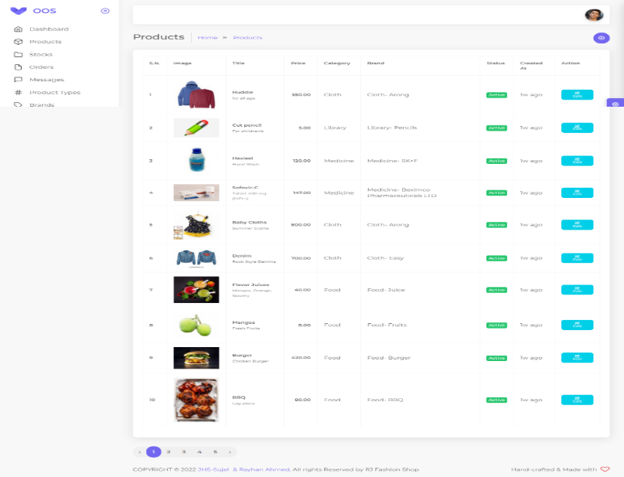
Products
This interface shows how many product there are and can be edited i.e. product activated and inactivated.

Slide 22
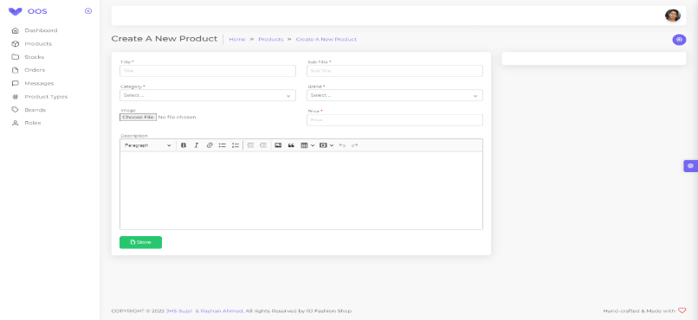
Product Create
With this interface, products can be added by their title, sub title, category, brand, image, price and description.

Slide 23
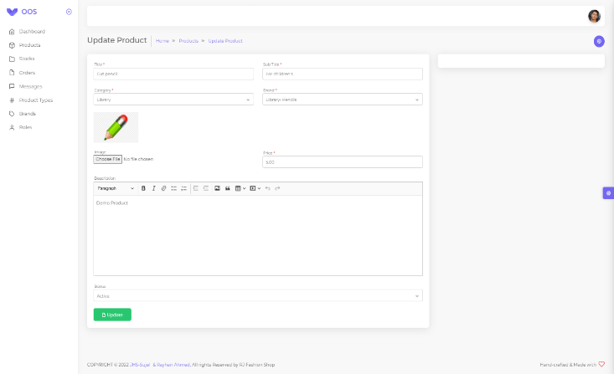
Product Edit
With this interface, admin can update after creating the product. It can be edited by their title, sub title, category, brand, image, price and description.

Slide 24
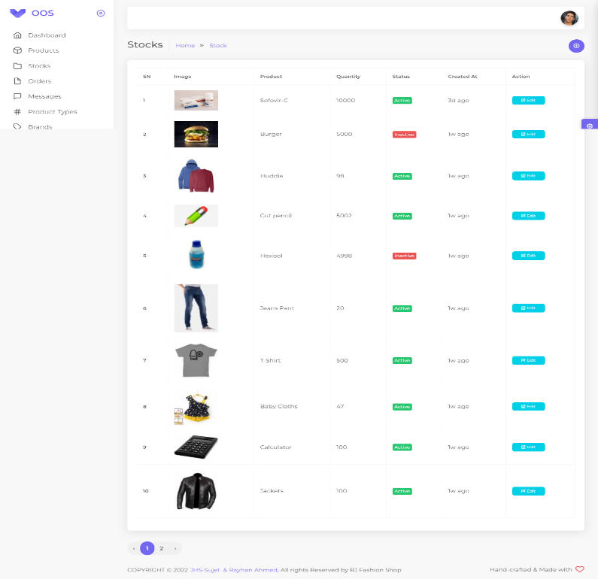
Stocks
When the products are added, the products have to be stocked to be displayed in the user interface, otherwise the products will show “ out of stock “

Slide 25
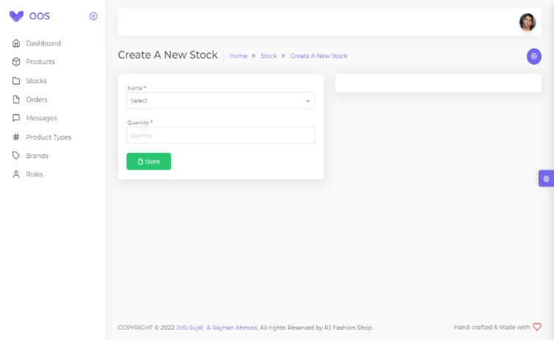
Stock Create
The product are named according to the name under which they were saved and the products are stocked with their quantity

Slide 26
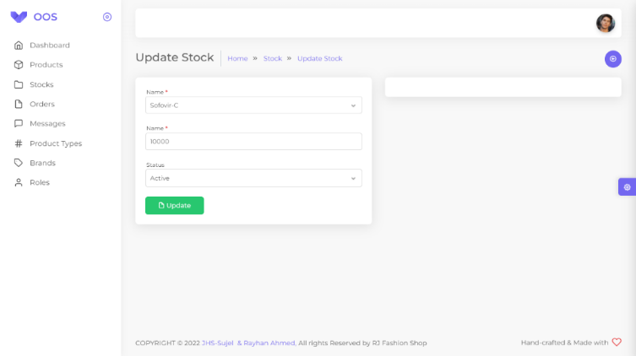
Stock Edit
Admin will be able to activate and inactivate the product form stock. Which will show up as out of stock in the user interface.

Slide 27
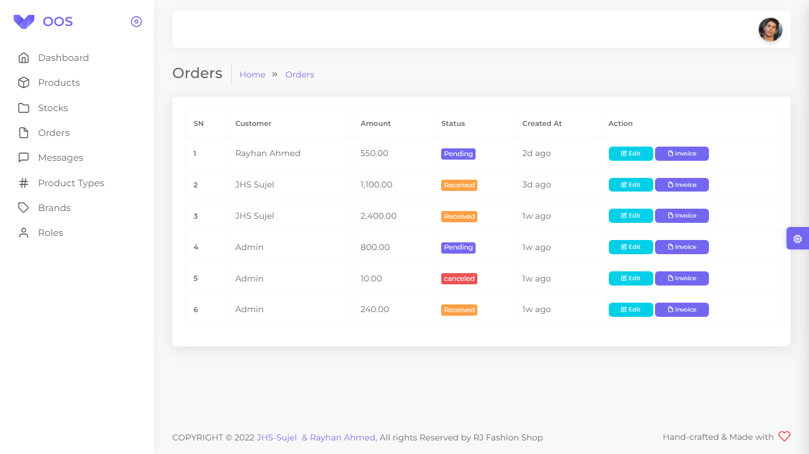
Order‘s
The admin will be able to see how many products the customer has ordered.

Slide 28
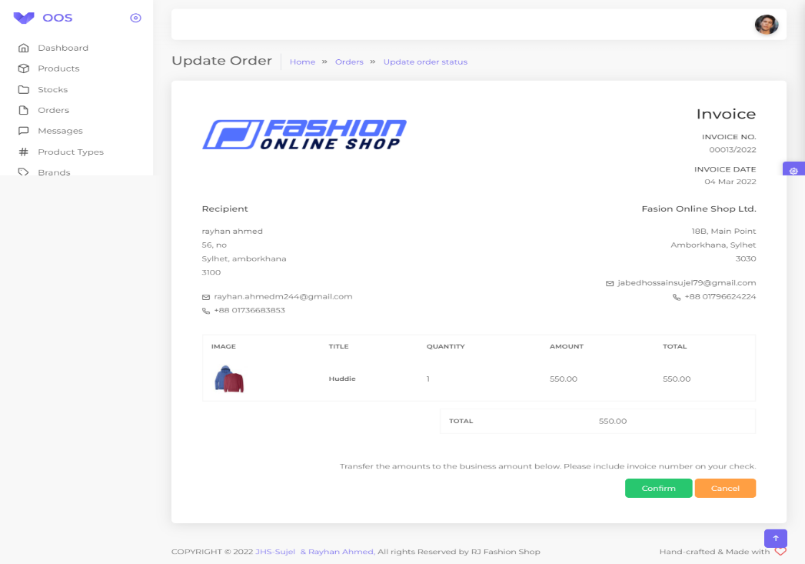
Invoice
Admin will be able to cancle or confirm the order. Also invoice will be given as document.

Slide 29
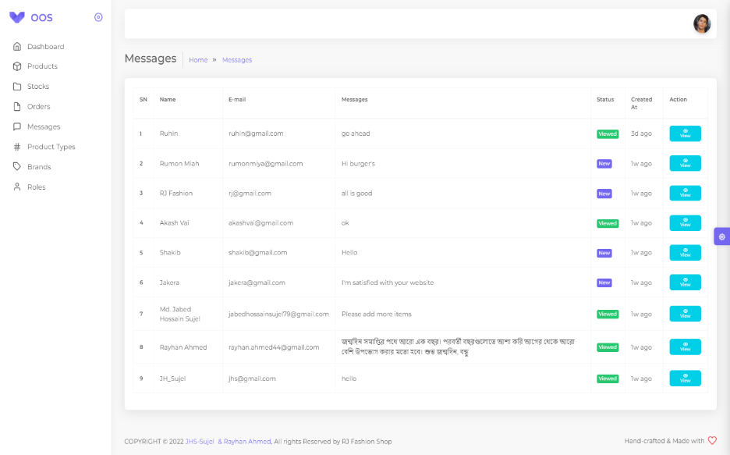
Message
From this interface the admin can see how many messages have come from viewers and customers.

Slide 30
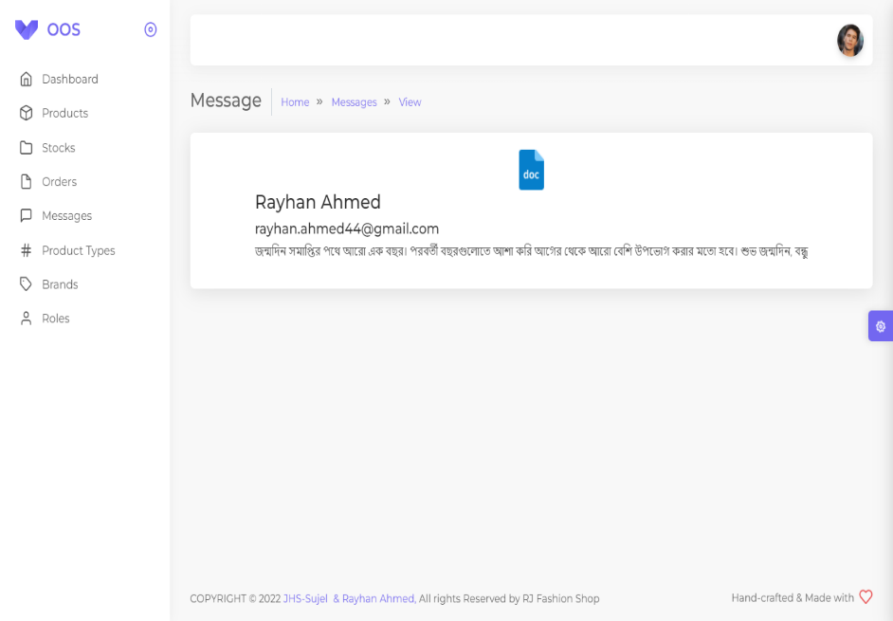
Message View
Admin will be able to see messages from viewers and customers.

Slide 31
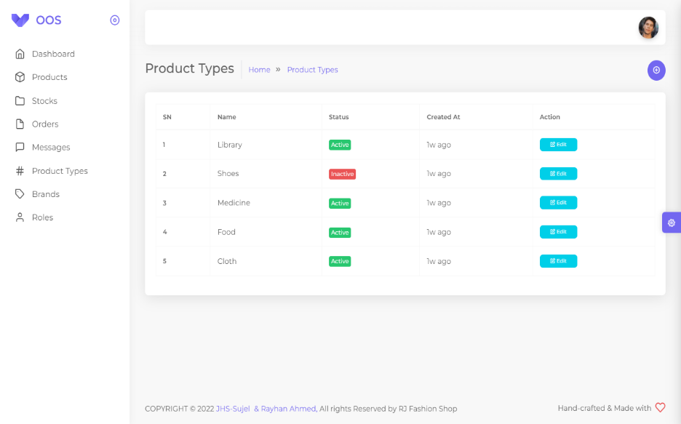
Product Types
The admin will be able to see how many products categories there are.

Slide 32
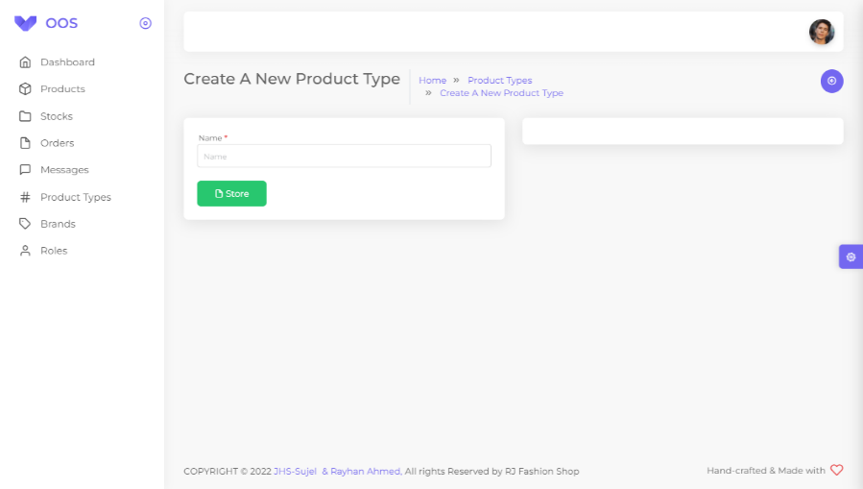
Product Types Create
Admin will be able to add different categories according to the name of their categories.

Slide 33
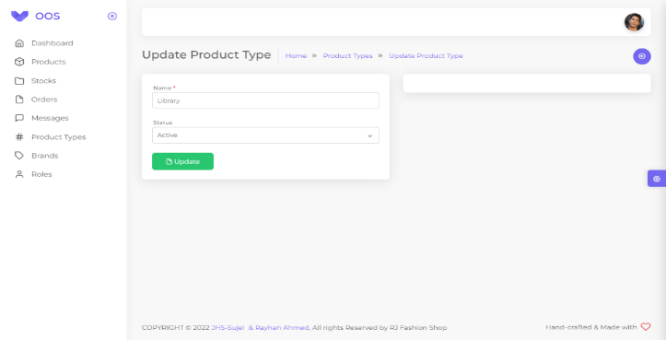
Product Types Edit
Admin will be able to edit the product according to the category name and activate, inactivate them.

Slide 34
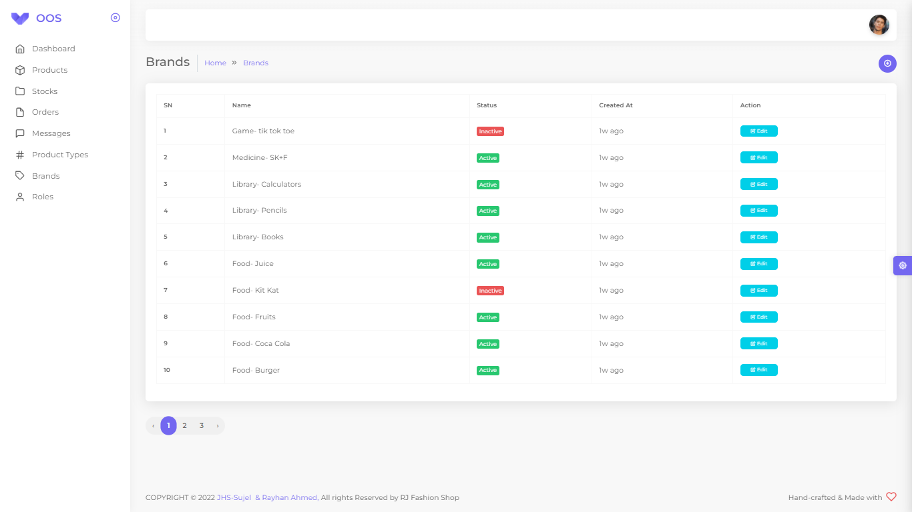
Brand‘s
The admin will be able to see how many product brands there are.

Slide 35
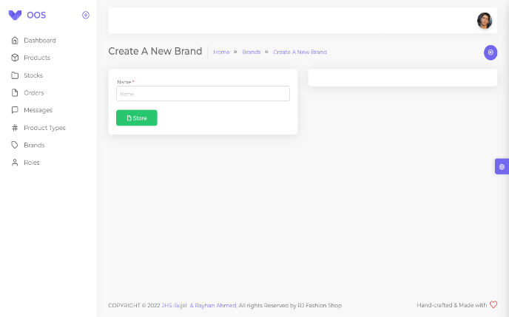
Brand‘s Create
Admin will be able to add different brands according to the name of their brands.

Slide 36
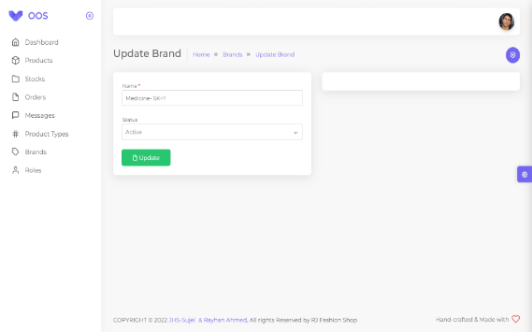
Brand‘s Edit
Admin will be able to edit the product brands according to the brands name and activate, inactivate them.

Slide 37
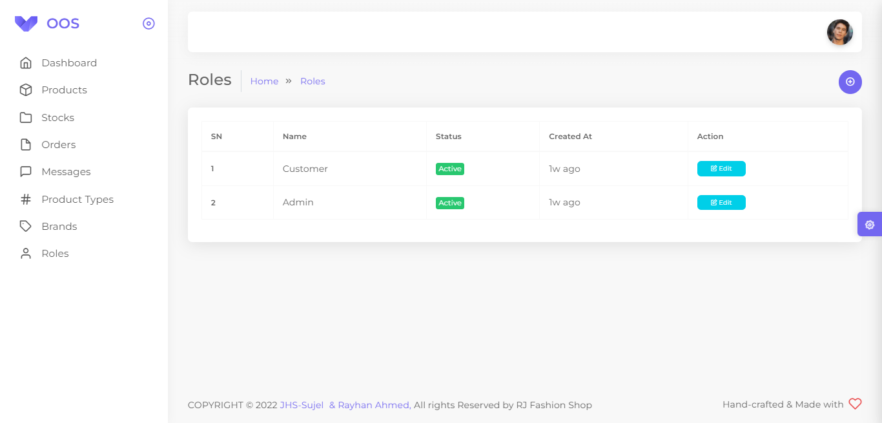
Roles
The admin will be able to see how many rules there are.

Slide 38
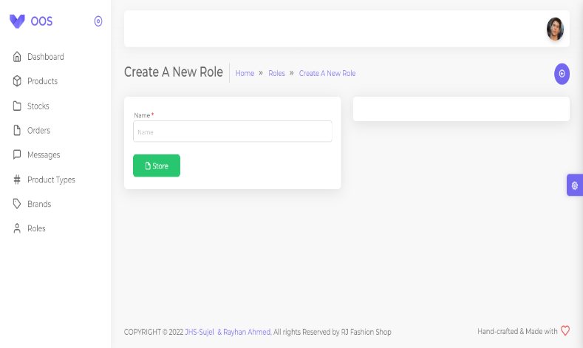
Roles Create
Admin will be able to add different rules according to the name of their rules.

Slide 39
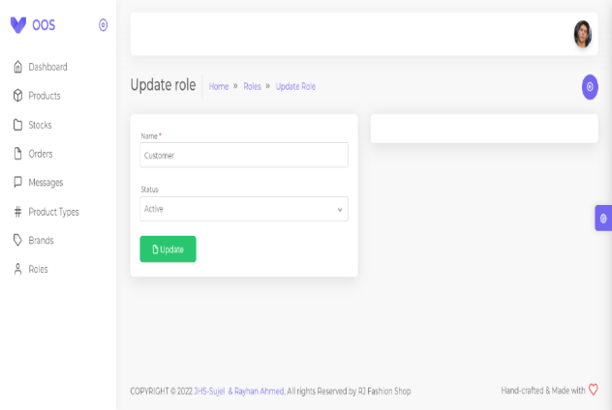
Roles Edit
Admin will be able to edit the rules according to the rules name and activate, inactivate them.

Slide 40


Feasibility
User Login
Customer
Admin
Economical
Free registration
View all products
Add to cart
Order
Message
Advance Security
Internet costs only, among other things.
Can manage all program

Slide 41

Future Work
01
Want to increase facilities of this project.
02
Want to add payment method like bKash, nagad etc.
03
Want to develop graphical design.
04
Want to add credit card option when we will starting our business by domain help.
05
Want to remove all the limitation.
06
Want to publish this website in online.

Slide 42
Thank You!

